Slide 1
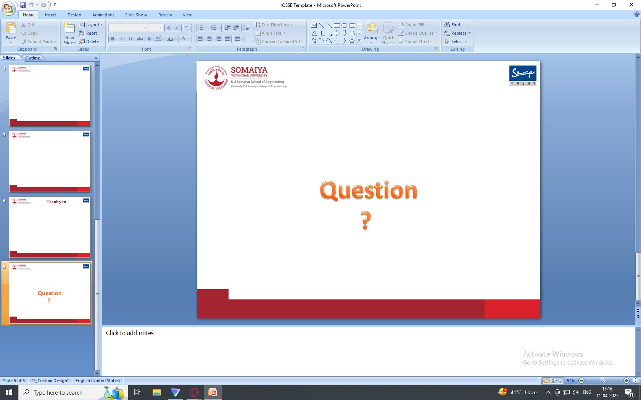

IS - IA1
BurpSuite
Daksh Girdhar
16010122059
Dhruv Desai
16010122038
Zayaan Gauri
16010122058
HUZAIFA ANSARI 1608

Slide 2
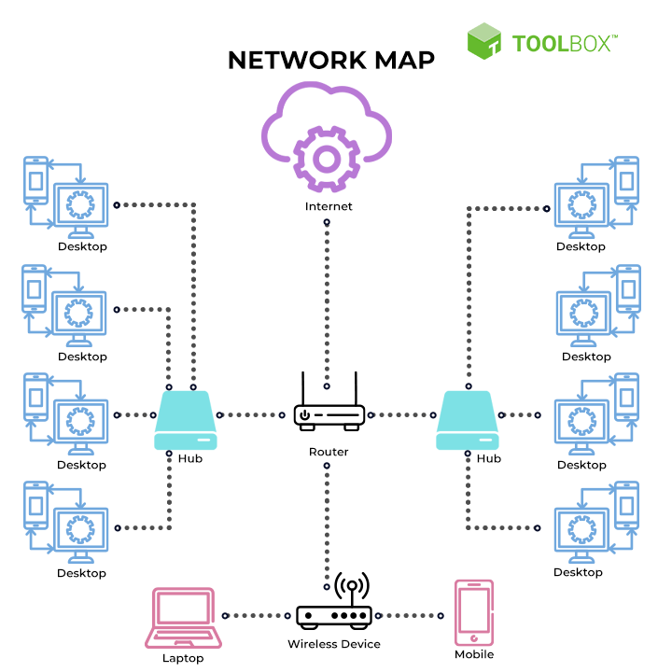
Introduction & Motivation
Burp Suite, developed by PortSwigger, is a widely used penetration testing tool for identifying
and exploiting web application vulnerabilities. Written in Java, it acts as an intermediary
between a browser and the target server, enabling users to intercept, analyze, and manipulate
HTTP/HTTPS traffic. It is essential for security professionals conducting web security
assessments, aiding in detecting vulnerabilities like SQL Injection, Cross-Site Scripting (XSS),
and authentication flaws. With both automated and manual testing features, Burp Suite provides
a comprehensive security evaluation.

Slide 3

SCOPE
The scope of this project encompasses a comprehensive study and practical exploration of Burp Suite, a leading web application security testing tool. It includes detailed analysis and hands-on usage of various tools integrated within Burp Suite such as Proxy, Repeater, Intruder, Decoder, Comparer, and Target. The project aims to evaluate Burp Suite’s capability in identifying and exploiting web vulnerabilities like SQL Injection, Cross-Site Scripting (XSS), and authentication flaws. It also explores the limitations and challenges associated with using the tool, particularly for large-scale applications or beginners in the cybersecurity domain.

Slide 4
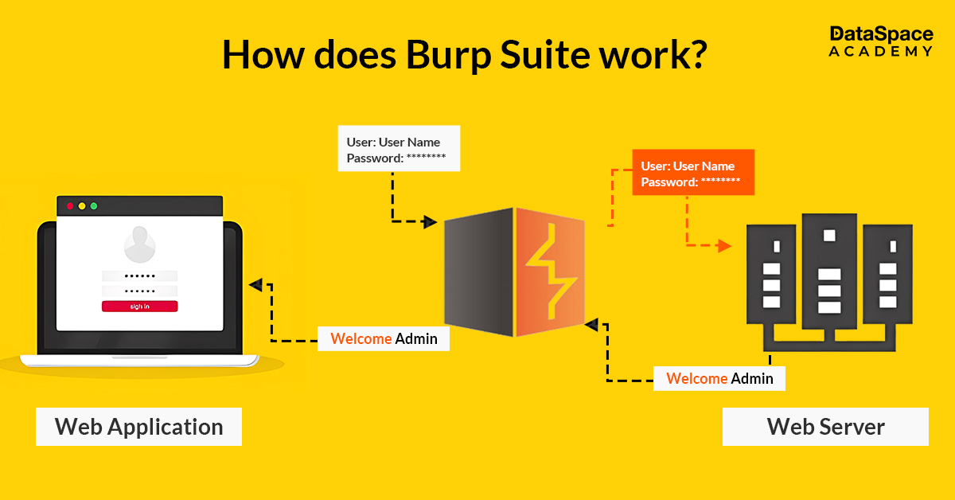
Objectives
To understand the fundamental architecture and functionality of Burp Suite.
To explore and demonstrate the usage of key tools within Burp Suite including:
Burp Proxy for intercepting and modifying HTTP/HTTPS traffic.
Burp Repeater for manual request analysis and testing.
Burp Intruder for automating attacks and payload testing.
Burp Decoder for encoding/decoding various formats and hashes.
Burp Comparer for identifying changes between web responses.
Burp Target for mapping and analyzing web application structure.
To perform practical testing on sample web applications using Burp Suite.
To identify and report common web application vulnerabilities using the tool.
To evaluate the tool’s limitations, including performance issues and learning curve.
To assess the role of Burp Suite in ethical hacking and penetration testing scenarios.

Slide 5
Features of Burp Suite
Burp Suite provides an extensive range of tools tailored for web security testing and penetration testing. It empowers security professionals to intercept, analyze, and manipulate web traffic, making it a cornerstone tool for ethical hacking and penetration testing:
Proxy: The Burp Proxy tool allows users to intercept and modify HTTP/HTTPS requests and responses between the client (browser) and the web server. It enables testers to analyze and manipulate requests for security testing purposes, such as injecting malicious payloads, modifying session tokens, and observing responses.
Intruder: Burp Intruder is an automated tool designed for brute force attacks, fuzzing, and injection attacks. It facilitates the testing of web application vulnerabilities by inserting payloads into predefined positions within an HTTP request. It is commonly used for password brute-forcing, testing authentication mechanisms, and discovering hidden endpoints.
Target: The Burp Target tool assists in managing findings and analyzing the structure of a web application. It provides a visual sitemap of the application, which is invaluable for planning penetration tests and defining the scope of testing.

Slide 6
Repeater: The Burp Repeater tool enables users to manually modify and resend HTTP requests multiple times without needing to capture them again. This is particularly useful for testing vulnerabilities such as SQL injection, Cross-Site Scripting (XSS), and authentication bypass attacks.
Sequencer: The Burp Sequencer tool analyzes session tokens and other data to assess their randomness and predictability. This is essential for evaluating the strength of authentication tokens and session management mechanisms.
Decoder: Burp Decoder facilitates the encoding and decoding of data, including URL encoding, Base64 encoding, HTML entity encoding, and more. It also supports various hash decoding techniques such as MD5, SHA-256, and BLAKE2B-256, making it a valuable tool for security testing and forensic analysis.
Comparer: Burp Comparer allows users to compare two sets of data, such as HTTP responses, requests, or binary data. It highlights differences between them, which is useful for analyzing changes in web application behavior during penetration testing.
Logger: The Burp Logger records all web traffic generated during a testing session. It provides a real-time record of all requests and responses, which is helpful for debugging and tracking security vulnerabilities

Slide 7
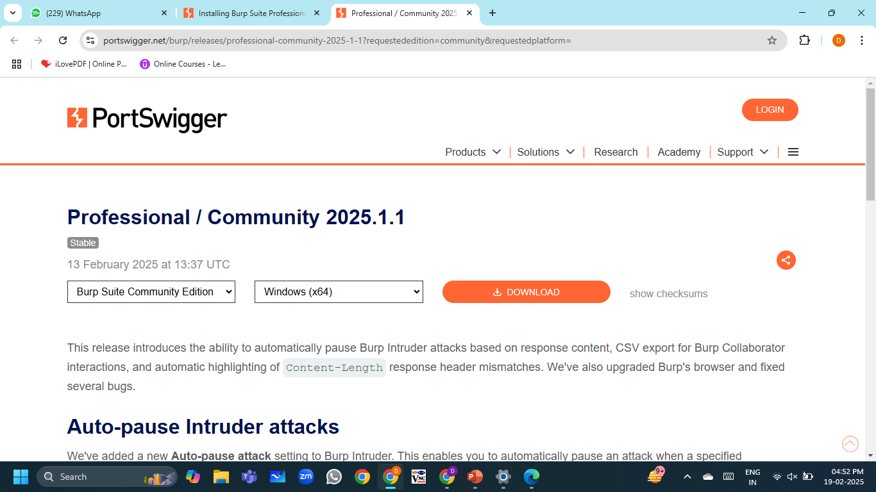
Burp Suite Installation:
Visit the Official Burp Suite Download Page and download the installation file.
Once downloaded, open the burpsuite_community_windows-x64.exe file and run the installer.
Follow the installation prompts, set the installation path, and click Next.
Allow the installer to complete the installation process.
Click Finish once the installation is complete.

Slide 8
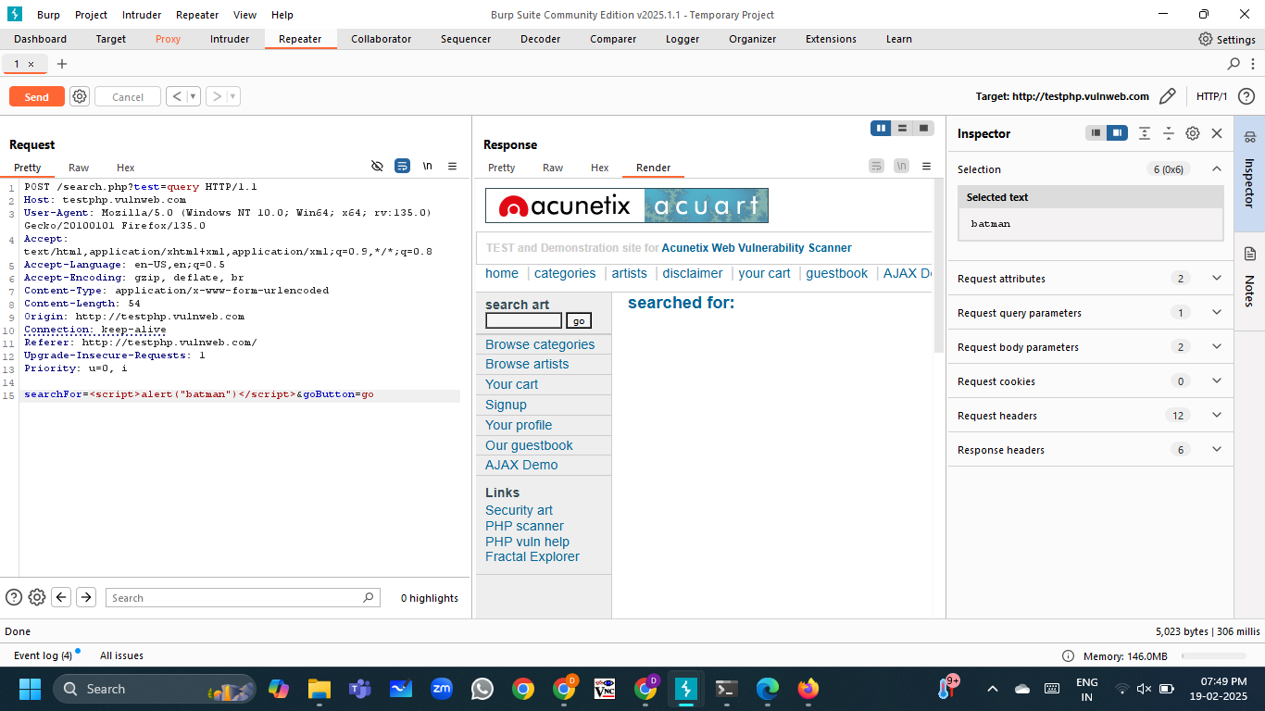
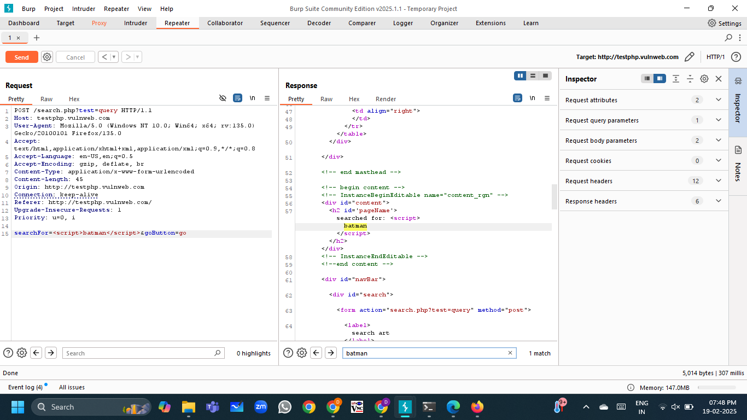
Burp Suite Implementation

Slide 9
Limitations
Burp Suite is a powerful tool for web application security testing, but it does have some limitations, including:
Complexity for Beginners: The tool can be overwhelming for beginners due to its advanced features and options.
Performance Issues: It may become slow or resource-intensive when handling large or complex web applications.
Limited Support for Non-HTTP Protocols: Burp Suite primarily focuses on HTTP/HTTPS and lacks native support for protocols like FTP, SMTP, or WebSocket.
Expensive Professional Version: The free version has limited features, and the Professional version comes with a high price tag.
Limited Automation: While it supports automation via APIs, it lacks out-of-the-box automation features compared to other tools.

Slide 10
Conclusion
Despite these limitations, Burp Suite remains a powerful and widely-used tool in the field of web application security. Its ability to provide both automated and manual testing capabilities, combined with its extensive feature set, makes it a go-to solution for security professionals. Whether used for identifying vulnerabilities, analyzing traffic, or debugging API communications, Burp Suite continues to play a critical role in ensuring the security of web applications.
In conclusion, while Burp Suite may have its challenges, its strengths far outweigh its limitations. For those willing to invest the time to master its features, Burp Suite offers unparalleled capabilities for conducting thorough and effective security assessments. As web applications continue to grow in complexity, tools like Burp Suite will remain essential for safeguarding digital assets and ensuring the integrity of online systems.

